Slide 1
A HMM Based on Daily Rate of Return for SSE
Chen Zhiyun 1501213406

Slide 2
Fctor Screening
Here I test 10 indicators in largest retracement, return to retracement and success rate.
indicator | swing | Logreturn | logreturn5 | boll | cci | dma | kdj | mtm | macd | sar
Largest retracement | 15% | 37% | 24% | 32% | 22% | 26% | 24% | 19% | 20% | 30%
Return to retracement | 24 | 3.8 | 15 | 9.6 | 25 | 9.1 | 12 | 22 | 15 | 8.7
Success rate | 85% | 55% | 70% | 53% | 64% | 53% | 51% | 64% | 53% | 53%

Slide 3
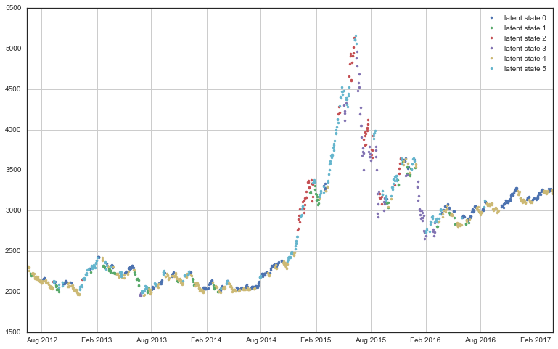
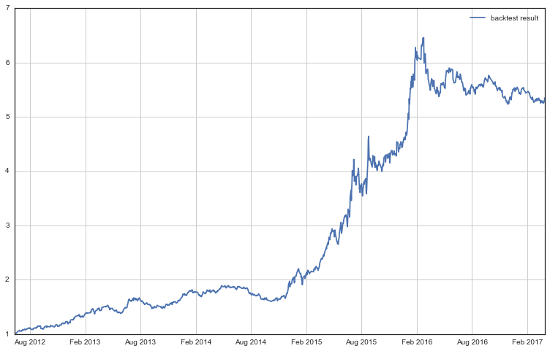
Finally, I choose swing and logreturn5 as my input factor.
Return in test period: 533%
Annualized return: 41%
Largest retracement: 19%
Return to retracement: 28
Success rate: 52.4%

Slide 4
Other thinking
In factor screening part, I find the result of logreturn5 is obviously better than logreturn. Is it means that hmm is more accurate in long period. I did another test on 1 day(1), 1 week(5), half a month(10), 1 month(20), three month(60).
indicator | Logreturn | logreturn5 | logreturn10 | logreturn20 | logreturn60
Largest retracement | 37% | 24% | 29% | 15% | 27%
Return to retracement | 3.8 | 15 | 13 | 31 | 7.1
Success rate | 55% | 70% | 58% | 74% | 63%

Slide 5
Other thinking
How to optimize our trading strategy?

